Slide 1
TLP - part 2: Multithreading, Synchronization
Oleg Ladin
06.04.2020

Slide 2
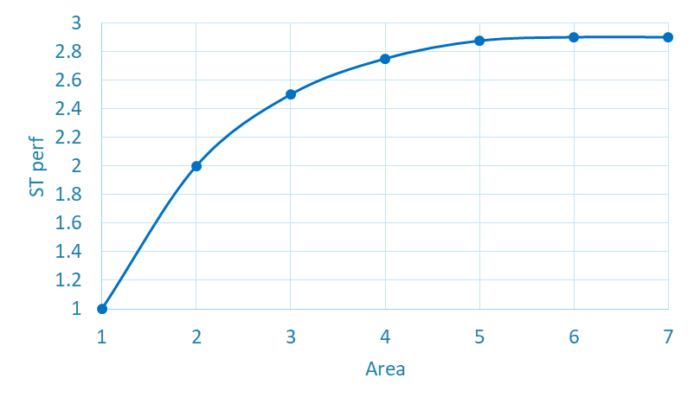
Refresher: Motivation
Increasing ST performance becomes harder and less power efficient
Area budget can be divided in several ways:
Single core 6x area, 2.9 performance boost
3 smaller cores 2x area, 2.0 performance boost each 6x area, 6.0 performance boost total!

Slide 3
Why ST performance doesn’t increase?
Data Flow Graph
2nd application
Most applications’ sustained throughput << the peak IPC
No ILP can be extracted → CPU resources are not used
Pipeline stall (e.g. cache miss) prevents forward execution
What is the solution? The solution is to run 2nd application on the same resources
CPU resources are utilized
Stalls are hidden by other thread processing
Ok, where can one find the 2nd application?
0
0
1
2
3
1
4
5
2
6
3
Schedule queue entries
6
6
3
4
5
2
4
5
1
2
3
1
1
2
3
0
0
0
EXE
EXE
EXE
EXE

Slide 4
Refresher: Thread-level parallelism
To achieve the best performance, workload should be parallelized to several threads
This is possible due to the thread-level parallelism (TLP)
Unlike ILP, TLP is extracted manually by programmer
Threads can be extracted either from:
The same application
Different applications running simultaneously
Operating system services
Previously each thread was executed on separate single core
Now assume each core could handle more than one thread execution
CPU supports ST and MT execution modes

Slide 5
Simultaneous Multithreading
Physically we have the same amount of cores
Logically there are twice more cores
OS schedules tasks on logical CPUs
Each logical processor maintains its own arch state
Complete set of architectural registers (General-purpose registers, Control registers, Machine state registers, Debug registers)
Instruction pointers
Each logical processor has its own interrupt controller
CPU
Core 1
Core 2
Cache
Memory

Slide 6

Resource Sharing
PC
PC
Fetch
Each pipe-stage is occupied by one of the threads
Resources are either replicated, partitioned or shared
Replicated resources are ones which are vital to maintain two fully independent contexts on each logical processor
Main source of HW size growth
Partitioned resources are mostly queues that decouple pipeline stages
Could be unified in ST execution mode
Shared resources are ones which don’t care about threading at all
Queue
Queue
APIC
Decode
APIC
Queue
Queue
Rename & Allocate
Arch State
SQ
Physical Registers
OOO Scheduler / Execute
Arch State
ROB
ROB
Retirement

Slide 7
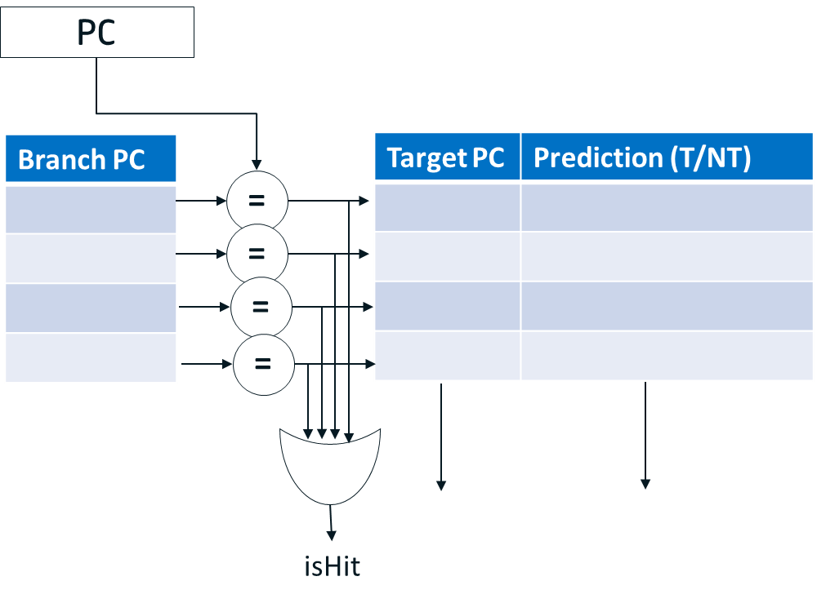
Example: Branch Predictor sharing
BP operates in terms of virtual addresses and has shared structure in MT mode
To avoid potential aliasing problems in case of virtual address overlapping BP entries could be marked with thread ID

Slide 8
Example: Schedule queue sharing
In MT mode schedule queue is dynamically partitioned
Each thread has its own small number of SQ entries
This prevents one thread monopolize whole machine resources
Each thread has ability for forward execution
Remained entries could be allocated by any thread
Schedule queue entries

Slide 9
Example: ROB replication
In MT mode ROB is partitioned, each part contains instructions only from one thread
Provide fairness execution of each thread
It’s complicated to make sharing scheme with dynamic repartitioning
Each thread has its own retirement logic
Stall in one thread doesn’t block retirement of another thread
In case of mispredictions, only instructions from affected thread are cleared
Retirement point (thread 1)
Retirement point (thread 2)

Slide 10
Example: Data cache sharing
Caches are addressed in physical addresses and considered as shared
If the data is common (cooperative workload), both threads hit to cache
Otherwise, LRU algorithm works
Ambiguity is avoided: physical address is thread-independent

Slide 11
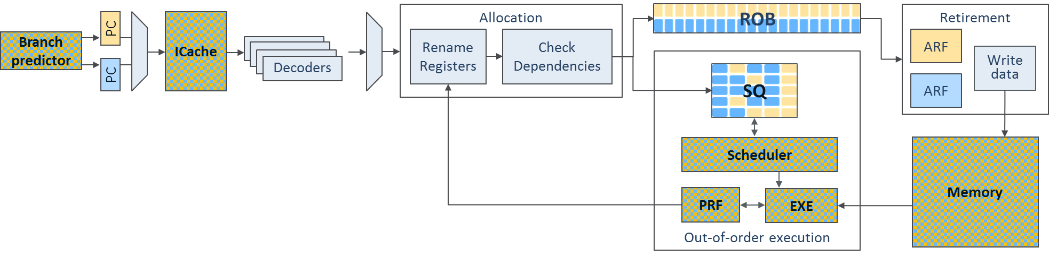
Resource sharing: pipeline overview
Overhead on HW size mostly comes from replicated resources
2x ARF, 2x PC, 2x APIC
Additional HW for thread switching between pipeline stages (thread selectors)
Still overhead is much less than 2x core

Slide 12
SMT pros and cons
Pros:
Increases overall system’s throughput by utilizing machine resources more effectively
Shadow pipeline hazards and allocation stalls
Introduce little addition HW (only replicated resources)
Cons:
ST performance of each thread is smaller
Could significantly drop performance due to cache thrashing
Unlikely help traces with enough ILP or high memory bandwidth

Slide 13
Implementations
SMT technology been around 1950s
First researched by IBM in ACS-360 project (1968)
Dean M. Tullsen et al – Simultaneous Multithreading: Maximizing On-Chip Parallelism – University of Washington (1995)
Major commercial CPU – DEC Alpha 21464 w/ SMT4 (cancelled 2001)
Intel Pentium 4 / Xeon – SMT2 support in NetBurst architecture (2002)
Modern implementations:
2 threads: Intel Atom/Core i7/Xeon (since 2008), AMD Ryzen, IBM Power 6
4 threads: Intel Xeon Phi, IBM Power 7 (8 cores - 32 threads)
8 threads: IBM Power 8/9 (12 cores – 96 threads)

Slide 14
Synchronization

Slide 15
Synchronization
We have already discussed Memory Coherence
Single core: Cache write policies (WriteThrough and WriteBack)
Multicore: MESI protocol
These mechanisms guarantee data correctness, while not algorithm correctness
Due to data races in Concurrent computing
Parallel cooperative tasks with common data require synchronization mechanisms:
Atomic operations
Transactional memory

Slide 16
Atomic operations
Synchronization with atomic operations
Ability to read and modify memory atomically (read-modify-write)
E. g. semaphores, MutEx (mutual exclusion), shared memory
Implemented as extensions of ISA (RISC-V):
Atomic memory operation (AMO) instructions (R-type) – for simple operations:
AMOSWAP.W; AMOADD.W; AMOMAX.W …
Complex Lock-free atomic read-modify-write operation: Load Reserved (Load Linked) + Store Conditional
try:
lr.w t0, (a0) # load value
# <update t0>
sc.w t1, t0, (a0) # try to update
bnez t1, try # retry if SC failed
SC returns 1 to T1 only if (A0) was not changed after LR of (A0)

Slide 17
Transactional memory
Transactional memory – allows a group of loads and stores to execute in an atomic way
Basically, the extension of LR/SC for a memory region
Helps workloads with little conflicts among threads:
Provides Optimistic concurrency control (OCC) – allows threads run in parallel without acquiring locks, assuming the intersection will not occur
Transaction is commited if conflict is not present. Otherwise it is reverted to initial state and rerun until conflicts are resolved.
Avoids deadlocks, while livelocks are still possible

Slide 18
Thank You

